Slide 1
First Project

Slide 2

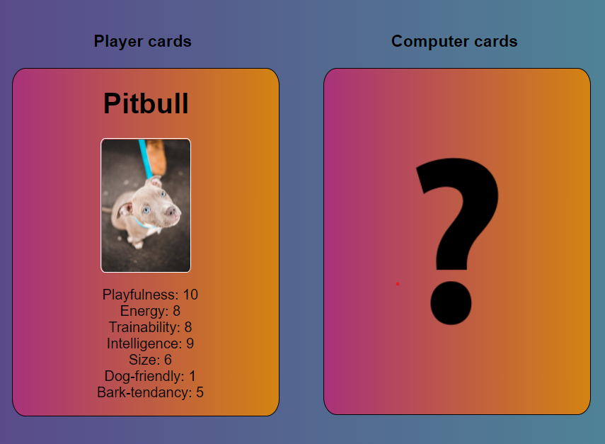
Top Trumps Game
How To Play
Replication of the Top Trumps guessing game.
User plays against the computer.
To win each round user's picked characteristic must be higher than computer’s matched characteristic.
Game ends when user or computer holds all of the cards.

Slide 3
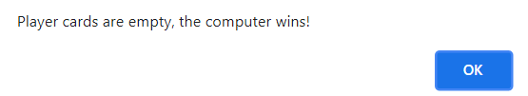
Key Features
Set Up Functions:
Focus on logic to shuffle, split and assign cards.
Match characteristics, Timeout and score dependent on user interaction (click).
Ending The Game:
One player holds the full cards array.
DOM manipulation to clear the screen and insert reset option.
Option for final round draw

Slide 4

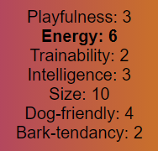
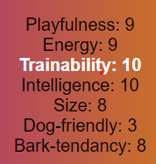

Aesthetics
Main Features:
Outline of rules
CSS to position elements clearly
Gradients and images
Enhance user interaction and clarity with font changes/ mouse-over effects

Slide 5
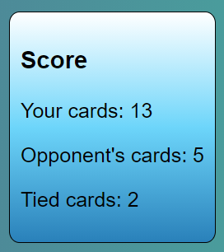
Challenges
pickPlayerCard(shuffledCardsPlayer) {
this.pickedPlayCard = shuffledCardsPlayer[0]
}
Main Learnings:
Understanding function parameters and arguments
Calling classes from neighboring files
CompareCards function: shift(), push() and including tied cards
Clearing screen/ adding elements with DOM manipulation
populatePlayerHand(currentHand.pickedPlayCard);
function populatePlayerHand(pickedPlayerCard) {
document.getElementById('player-hand').innerHTML =

Slide 6
Changes and Improvements
Start over:
Create a two player game.
Future improvements:
Add onclick to computer card in place of Timeout function.
Implement a replay round option if final two cards tie.

Slide 7
Live Demo:

